Slide 1

Machine Learning Models
MODELLING PUBLIC HEALTH DATA (MQB7046)
DR MOHAMAD ZULFIKRIE BIN ABAS

Slide 2

Outline
Experience sharing
Introduction to machine learning (ML)
Building ML-based prediction model
Hands on

Slide 3

Learning outcome
Understand the:
basic concept of ML
general approach in developing prediction model
Inspired to use ML approach in your research project.

Slide 4

Diabetic Complications Prediction Model

Slide 5
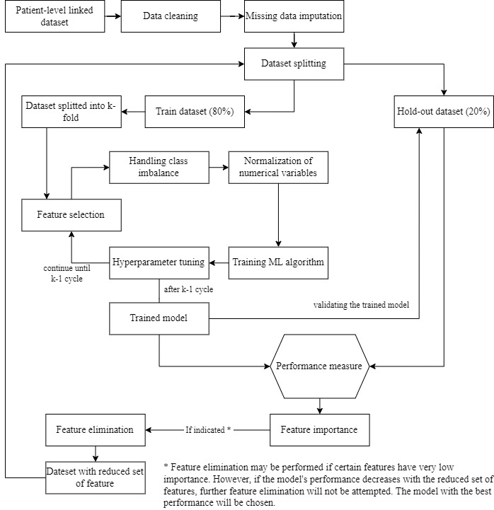
Model Building Strategy
Development of Prediction Models
Approach: Use of 7 machine learning algorithms
k-nearest neighbour (kNN)
Support vector machine (SVM)
Logistic regression (LR)
Decision tree (DT)
Random forest (RF)
Extreme gradient boost (XGB)
Light gradient boosting machine (LGBM)
Performance Comparison: Using ROC-AUC.

Slide 6
Results – machine learning prediction models
Table 5: ROC-AUC Score of The Developed Prediction Models for Each Diabetes Complications
 | k-NN | SVM | LR | DT | RF | XGB | LGBM
All-cause mortality | 0.78 | 0.65 | 0.78 | 0.78 | 0.79 | 0.84 | 0.84
Retinopathy | 0.64 | 0.52 | 0.62 | 0.58 | 0.61 | 0.69 | 0.70
Nephropathy | 0.65 | 0.53 | 0.64 | 0.59 | 0.65 | 0.7 | 0.71
Ischaemic heart disease | 0.63 | 0.51 | 0.63 | 0.56 | 0.6 | 0.66 | 0.66
CeVD | 0.67 | 0.61 | 0.66 | 0.5 | 0.65 | 0.71 | 0.74
LGBM algorithm showed the best performance in predicting the five complications with four models considered good performance (ROC-AUC ≥ 0.7)
XGB algorithm achieved relatively similar performance as the LGBM model but took a significantly longer time (between 7 and 13 times longer) to train.

Slide 7

My experience

Slide 8

Goals
It is feasible to explore something new to you and still able to complete the project in a timely manner
Guidance in any possible way for your MPH/DrPH journey

Slide 9

How I started my journey?

Slide 10
2021/2022
(1st sem)
2021/2022
(2nd sem)
2022/2023
(3rd sem)
2022/2023
(4th sem)
2023/2024
(5th sem)
2023/2024
(6th sem)

Slide 11


Slide 12
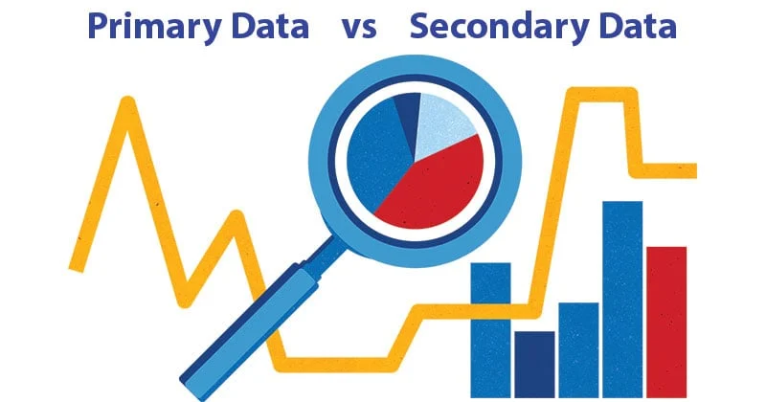
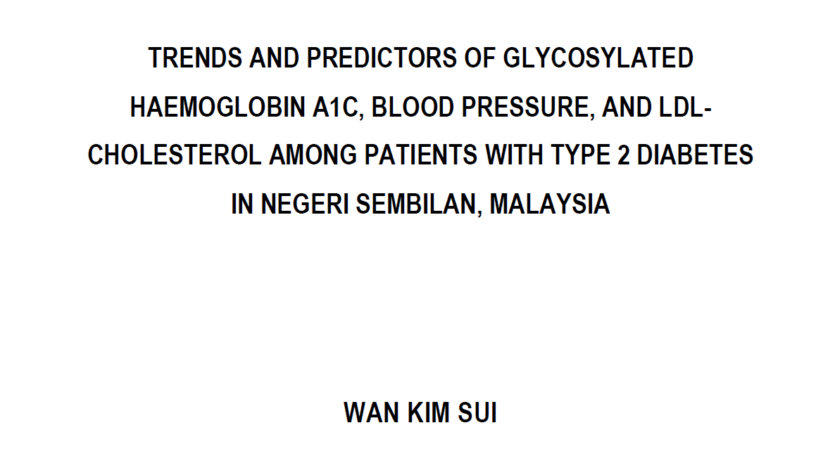

Slide 13

Are you OK with numbers?
Are you willing to learn machine learning?

Slide 14
What is machine learning?
Machine learning for beginners.
Basics of machine learning.

Slide 15
2021/2022
(1st sem)
2021/2022
(2nd sem)
2022/2023
(3rd sem)
2022/2023
(4th sem)
2023/2024
(5th sem)
2023/2024
(6th sem)

Slide 16








Slide 17
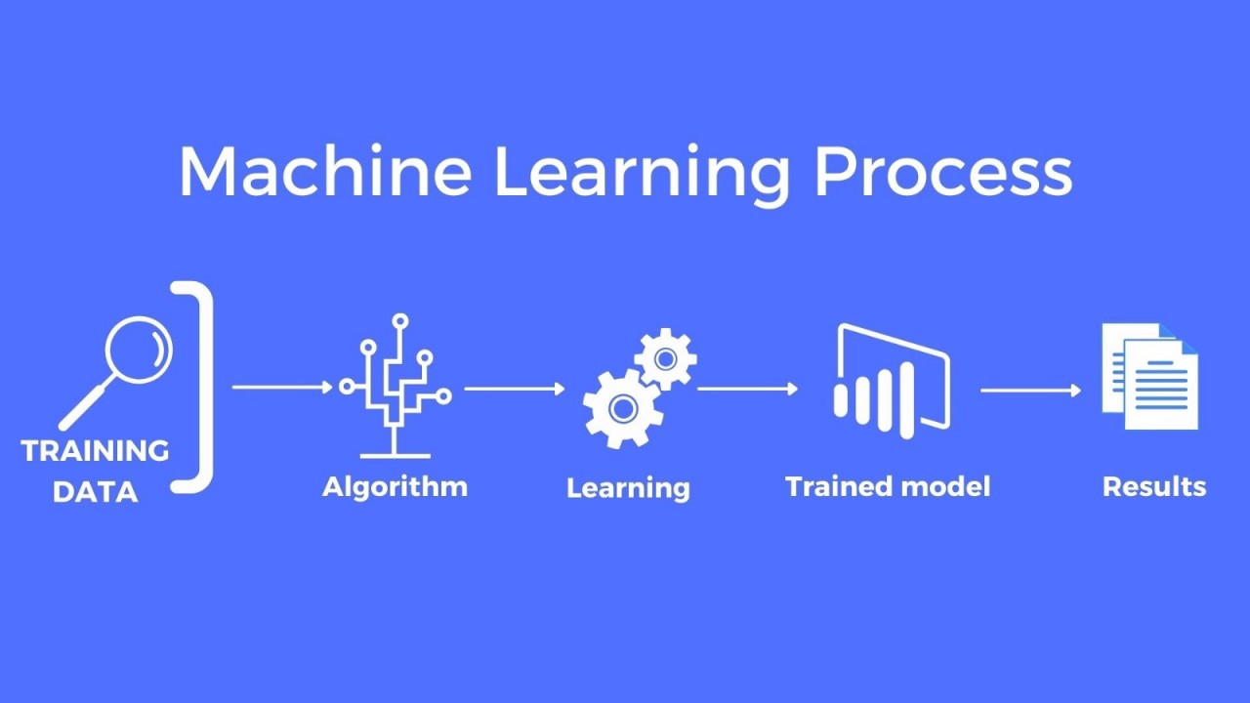
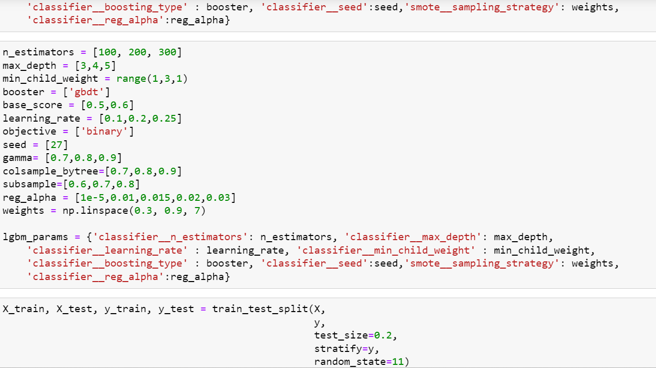

Slide 18
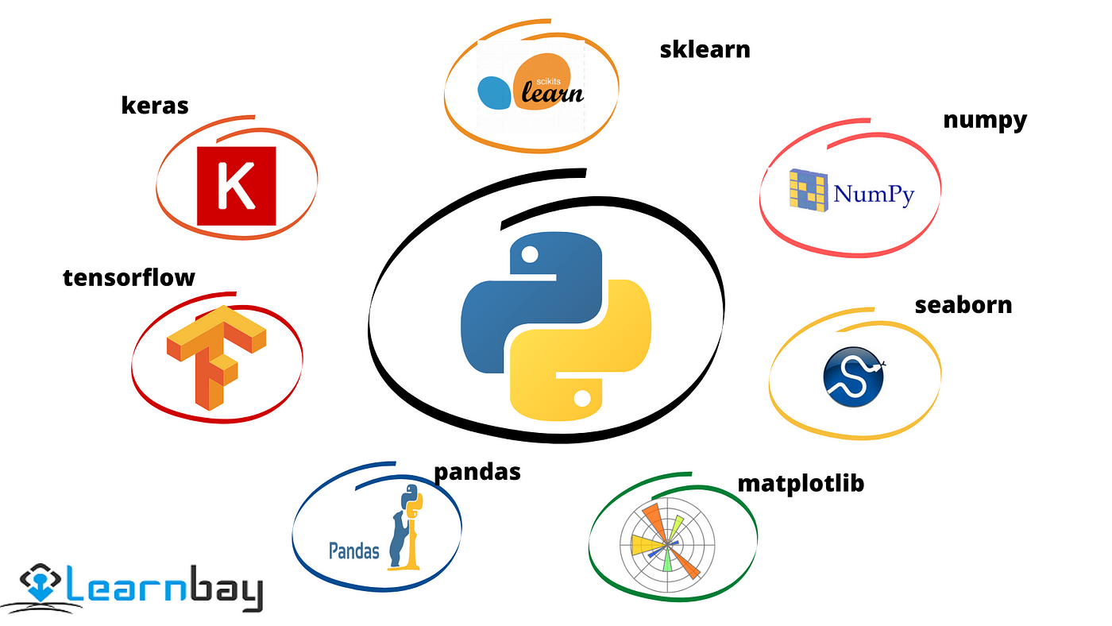

Slide 19
2021/2022
(1st sem)
2021/2022
(2nd sem)
2022/2023
(3rd sem)
2022/2023
(4th sem)
2023/2024
(5th sem)
2023/2024
(6th sem)

Slide 20

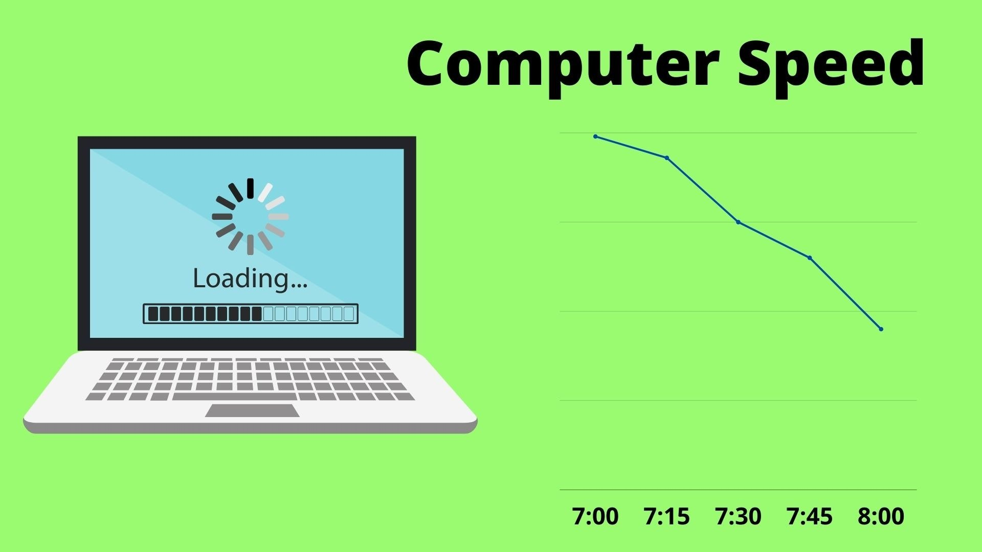

Slide 21
2021/2022
(1st sem)
2021/2022
(2nd sem)
2022/2023
(3rd sem)
2022/2023
(4th sem)
2023/2024
(5th sem)
2023/2024
(6th sem)

Slide 22





Slide 23

Introduction to Machine Learning

Slide 24

Machine learning
Machine learning (ML) is a branch of artificial intelligence (AI) and computer science that focuses on the using data and algorithms to enable AI to imitate the way that humans learn, gradually improving its accuracy.
Main Objective : Predictive modelling
Identify something based on a set of given criteria

Slide 25
Machine Learning
Artificial Intelligence
A technique which enables machines to mimic human behaviour
Artificial Intelligence
Machine Learning
Machine Learning
Subset of AI technique which uses specific algorithms to enable machines to improve with experience.
Deep Learning
Deep Learning
Subset of Machine Learning which make the computation of multi-layer neural network feasible

Slide 26



How do we learn?
Learning
Input
- Experience / Data
Output
- Task (Recognize color)
Test their performance – Quiz / Exam

Slide 27

How we train machine to learn?
Learning
Input
- Experience / Data
Output
- Task (Recognize color)
Test model performance – Accuracy, F1 score, MSE, …

Slide 28
What happen to human intelligence if
Input
Output
Unclear input
Unclear output
Precise Input
Precise output

Slide 29
Same thing happen in machine
Input
Output
GIGO
Unclear input
Unclear output
Garbage In Garbage Out
Precise Input
Precise output

Slide 30
Common terms
The following terms are used interchangeably:
Row, observation, datapoint, instance (SUBJECTS)
Column, attribute, feature (VARIABLES)
Target attribute, target, label (DEPENDENT VARIABLE)
A target attribute is one we are interested in predicting

Slide 31
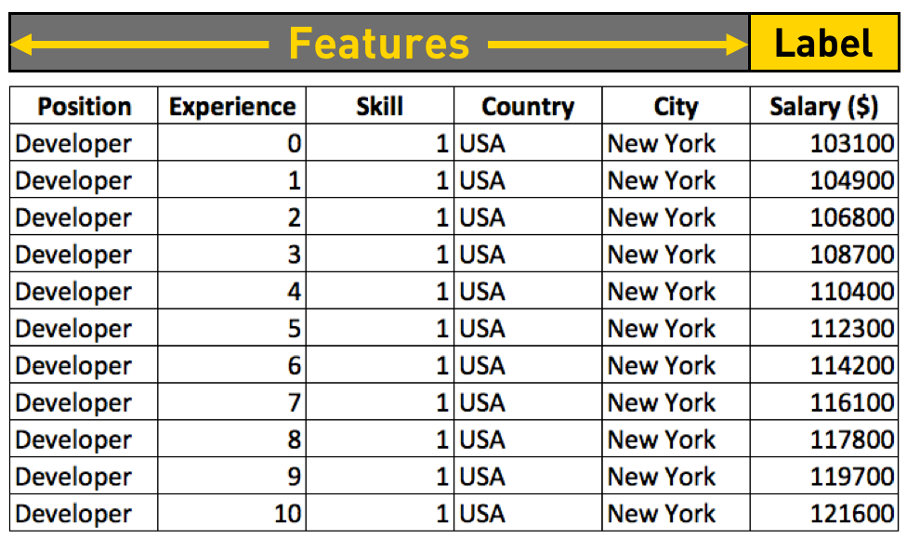
Features and Labels
Tabular Data
Instance

Slide 32
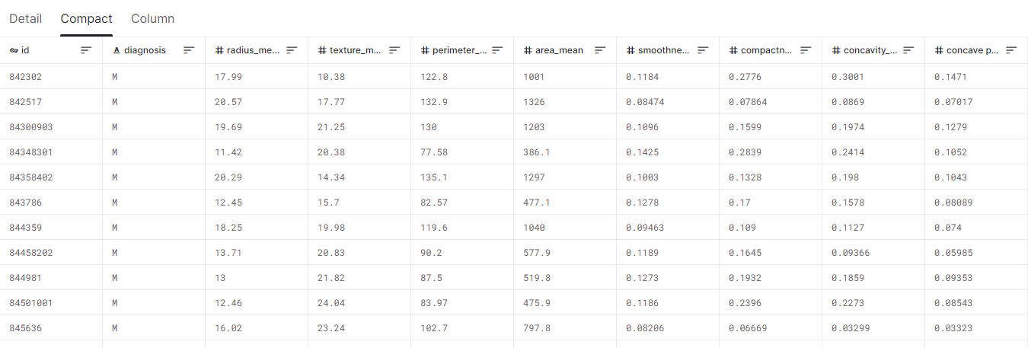
Features and Labels
Tabular Data – Breast cancer datasets
Features
Label
Source: https://www.kaggle.com/datasets/uciml/breast-cancer-wisconsin-data

Slide 33
Machine Learning Techniques
Supervised Learning
Reinforcement Learning
Unsupervised Learning
Discover patterns in the data that relate data attributes with a target (class) attribute.
The data have no target attribute.
Interacts with environment, decide action, learns by trial and error method

Slide 34
Supervised Learning
is a machine learning paradigm for problems where the available data consists of labeled examples, meaning that each data point contains features (covariates) and an associated label.
Goal of supervised learning algorithms is learning a function that maps feature vectors (inputs) to labels (output), based on example input-output pairs.

Slide 35
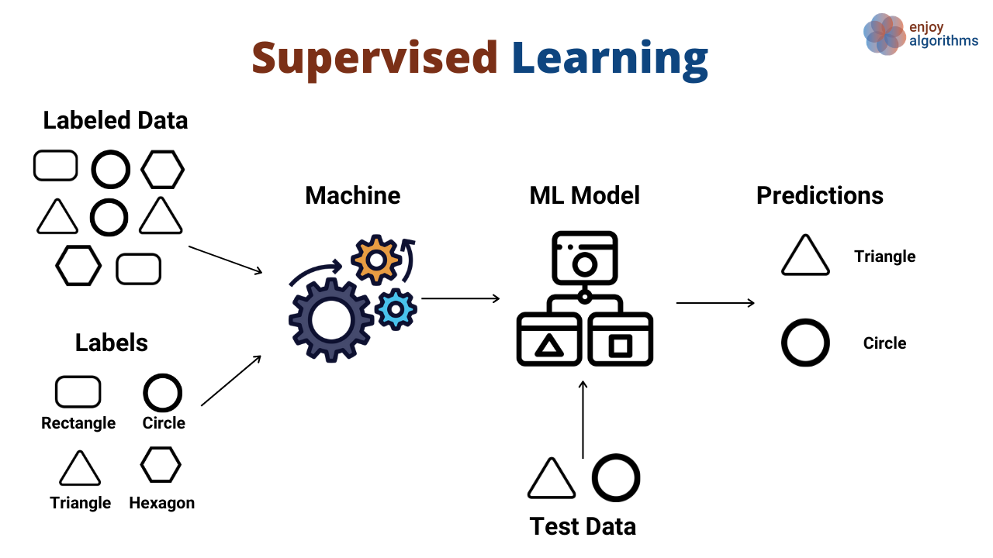

Slide 36
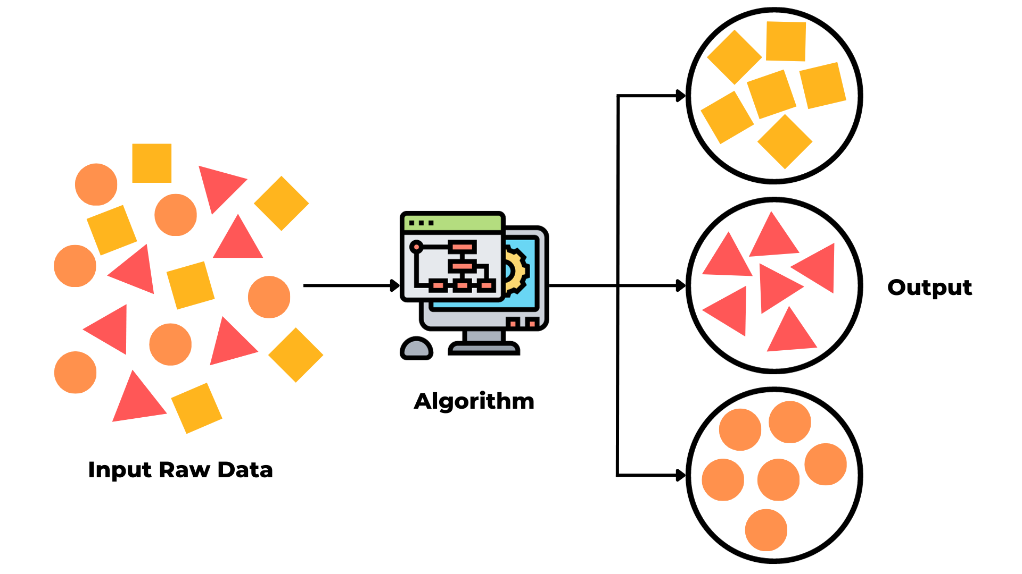
Unsupervised learning

Slide 37
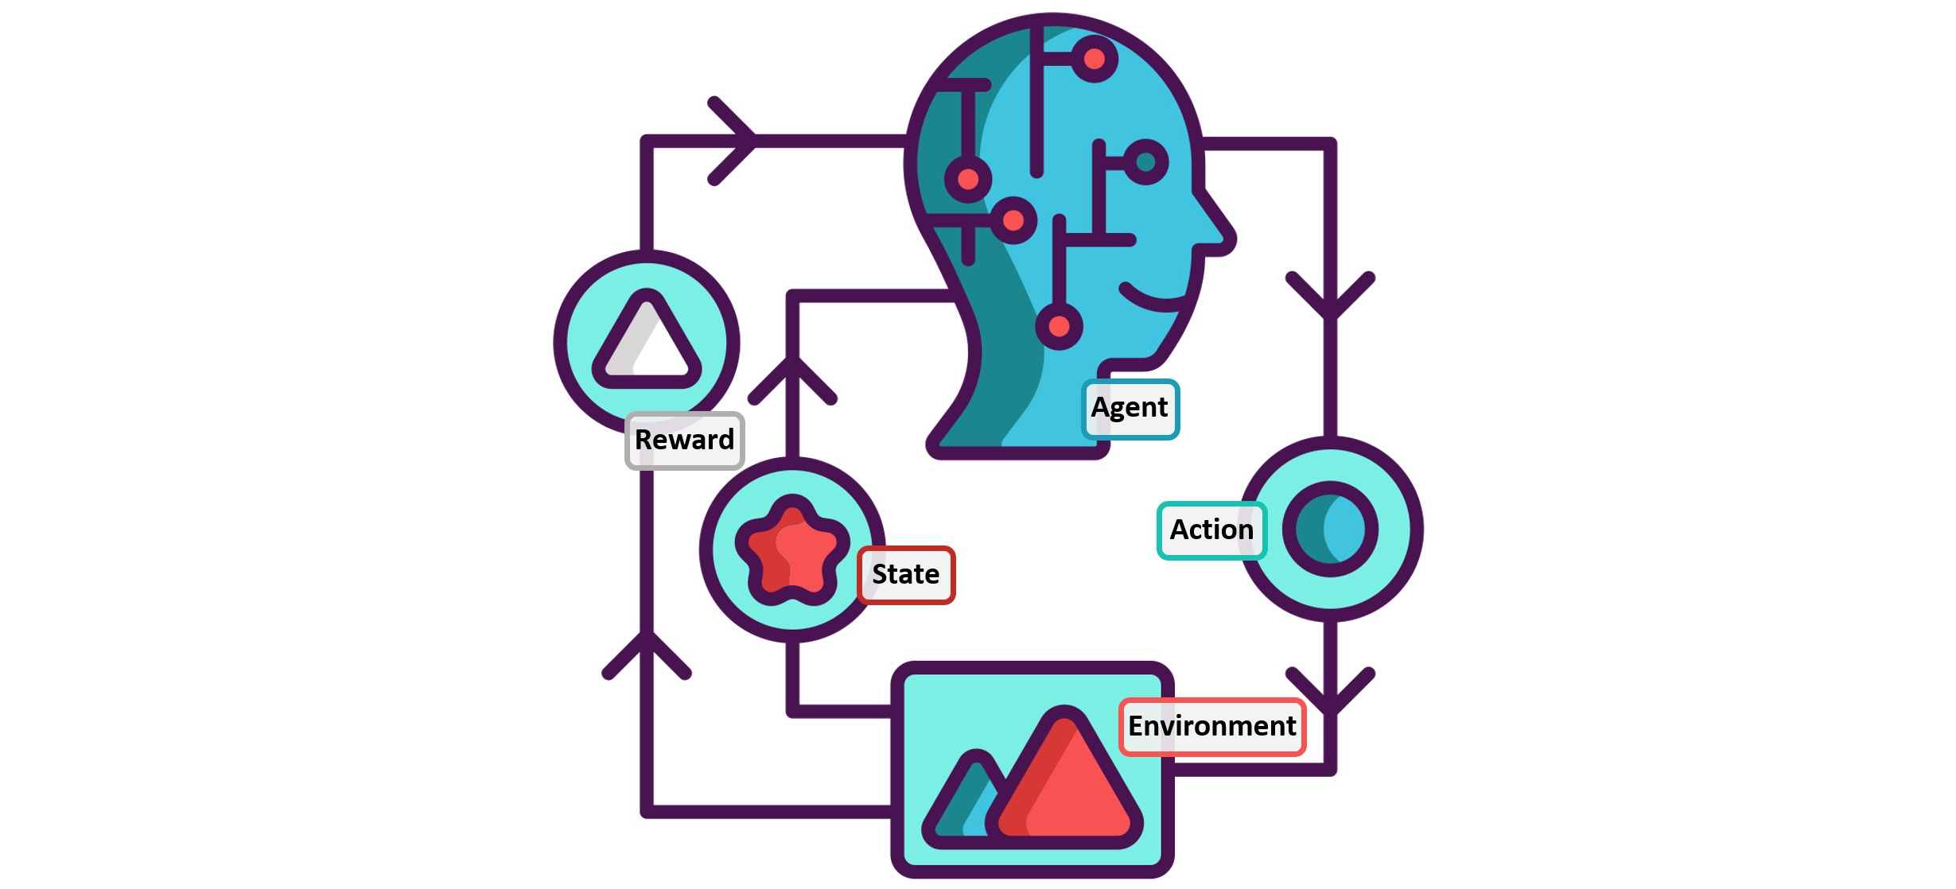
Reinforcement learning

Slide 38
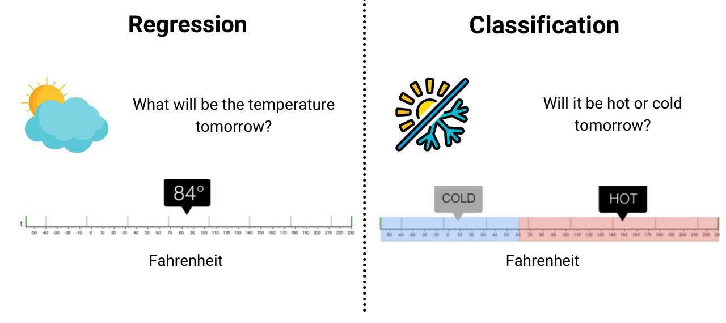
Supervised Learning
Continuous Variable
Categorical Variable

Slide 39
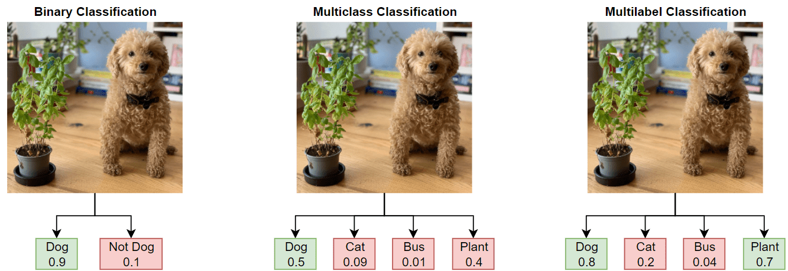
Type of Classification Problems
Source: https://www.mathworks.com/help/deeplearning/ug/multilabel-image-classification-using-deep-learning.html

Slide 40
Differences between ML model and statistical model
 | Machine Learning Model | Statistical Model
Goal | Predictive modeling, pattern recognition, and automation of decision-making. | Inference about the relationships among variables and hypothesis testing.
Data Requirements | Large datasets, often with many features, to learn complex patterns and relationships. | Relatively smaller datasets, focusing on selected variables to test specific hypotheses.
Assumptions | Less reliant on strict assumptions about the underlying data distribution. | Assumes a specific distribution and often requires adherence to assumptions for valid results.
Complexity | Capable of handling complex, non-linear relationships. | Typically assumes linear relationships and may struggle with highly complex data.
Interpretability | Some models, especially deep neural networks, can be less interpretable. | Generally more interpretable, providing clear insights into the relationship between variables.

Slide 41
Building ML-Based Prediction Model

Slide 42
Machine learning algorithm
Supervised
Unsupervised
Reinforced
Regression
Classification
Binary
Multiclass
Multilabel

Slide 43
Basic Steps in Model Building
Data Preparation
Data Splitting (Train/Test)
Model Training
Model Evaluation

Slide 44
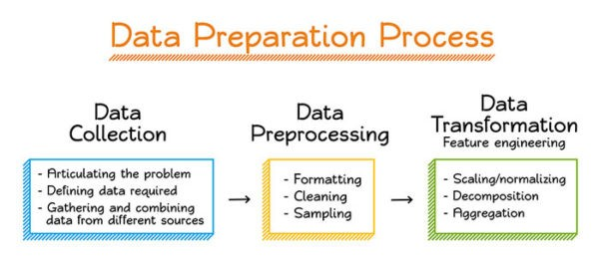
Data Preparation
Data Splitting (Train/Test)
Model Training
Model Evaluation

Slide 45
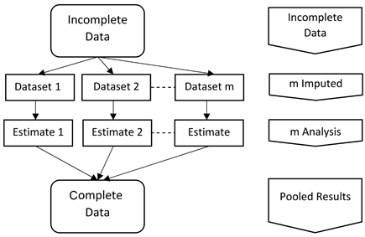

Slide 46
Data Preparation
Data Splitting (Train/Test)
Model Training
Model Evaluation
Data | Feature1 | Feature2 | Feature3 | Label
Data1 | 23 | 3 | Cold | Cold
Data2 | 12 | 51 | Cold | Hot
Data3 | 1 | 12 | Hot | Hot
… | … | … | … | …
DataN | 15 | 65 | Hot | Cold
70%
Training
30%
Testing

Slide 47
Data Preparation
Data Splitting (Train/Test)
Model Training
Model Evaluation
Data | Feature1 | Feature2 | Feature3 | Label
Data1 | 23 | 3 | Cold | Cold
Data2 | 12 | 51 | Cold | Hot
Data3 | 1 | 12 | Hot | Hot
… | … | … | … | …
DataN | 15 | 65 | Hot | Cold
70%
Training

Slide 48
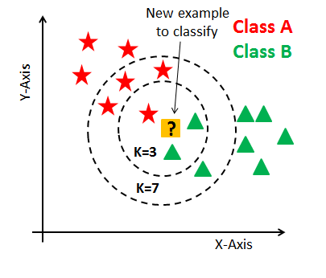
K-Nearest Neighbour

Slide 49
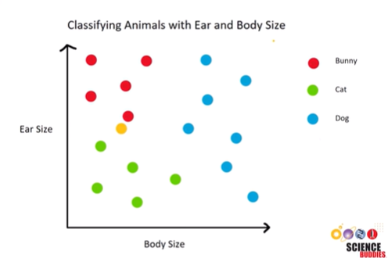

Slide 50
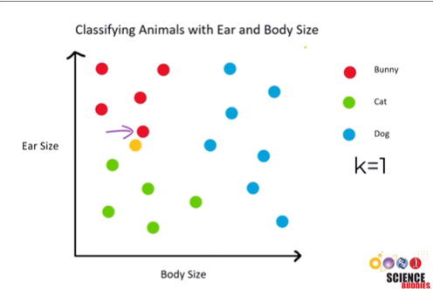

Slide 51
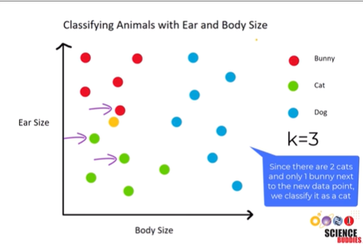

Slide 52
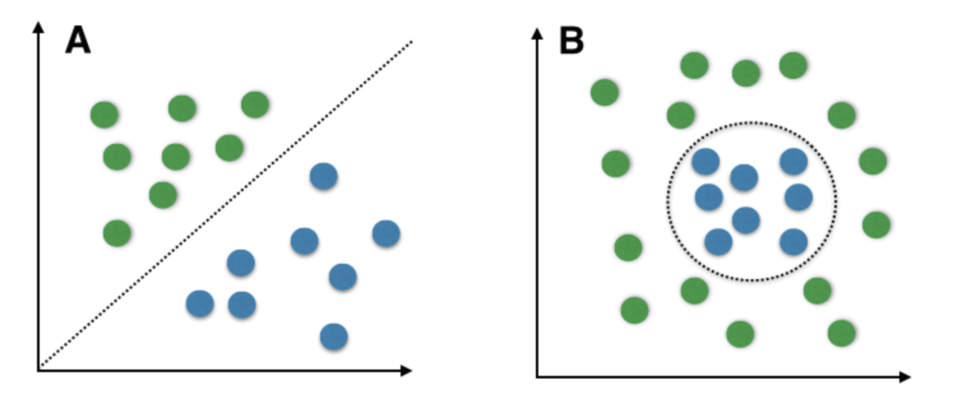
Support Vector Machine

Slide 53
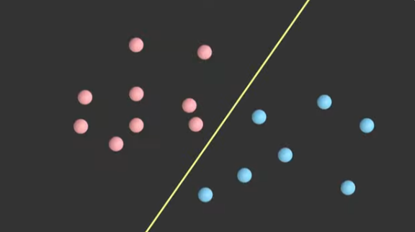

Slide 54
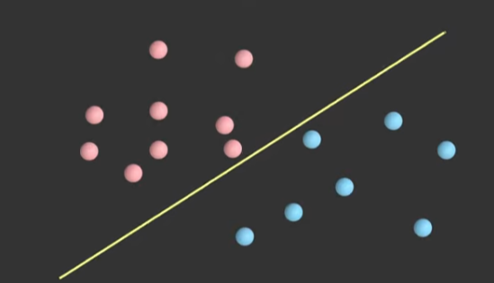

Slide 55
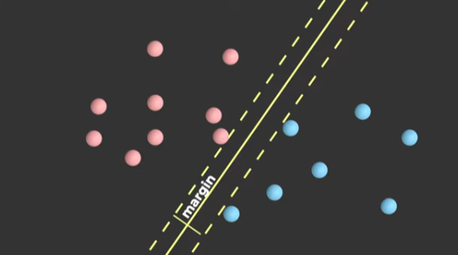

Slide 56
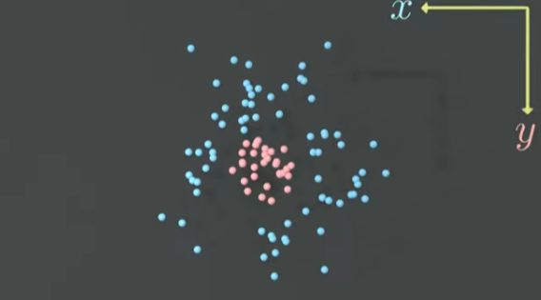

Slide 57
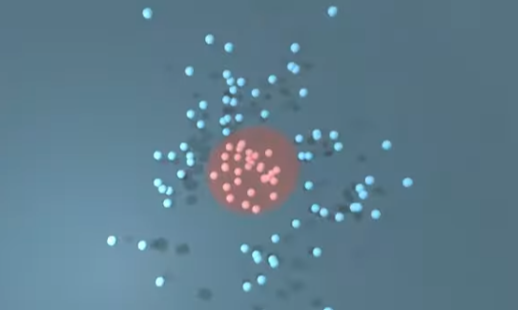
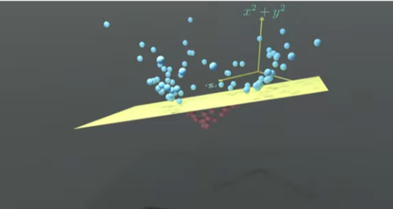

Slide 58
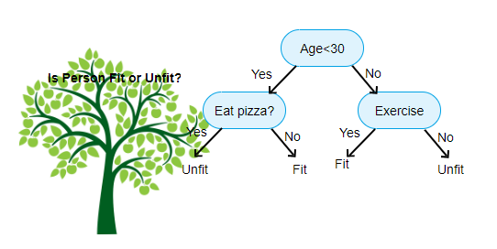
Decision Tree

Slide 59
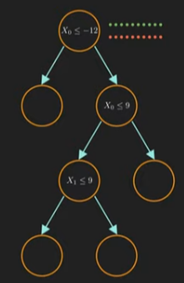
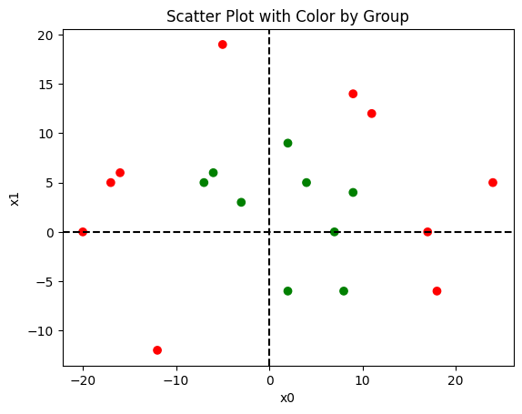

Slide 60
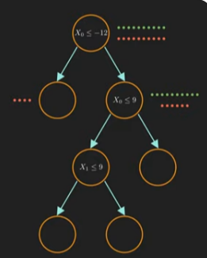
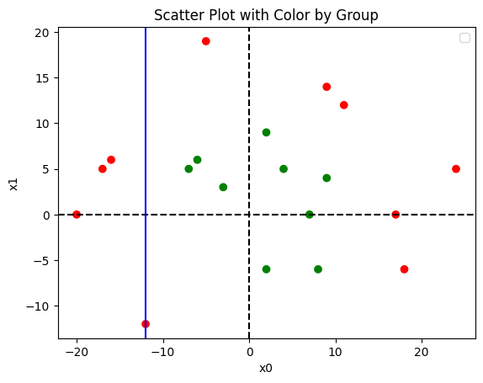
yes
no

Slide 61
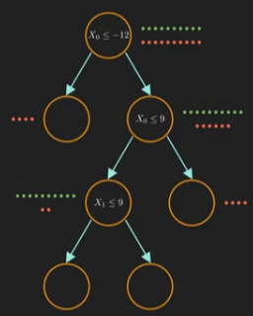
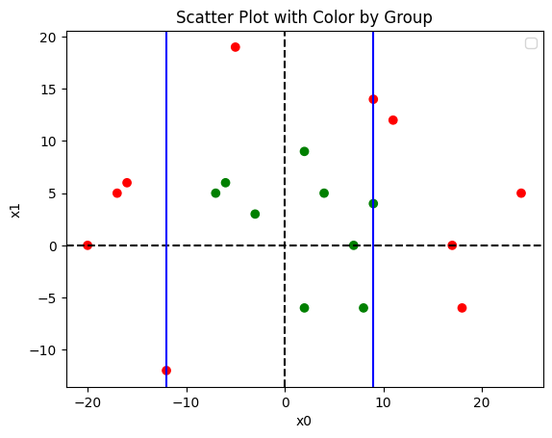
yes
no
yes
no

Slide 62
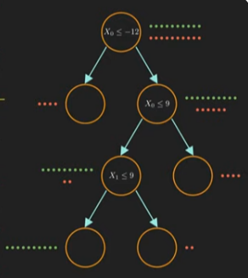
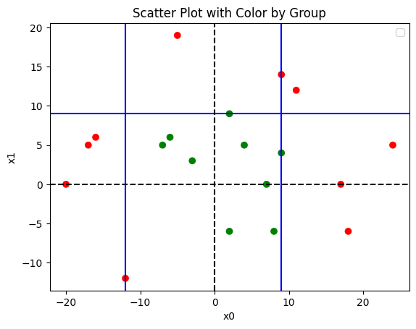
yes
no
yes
no
yes
no

Slide 63
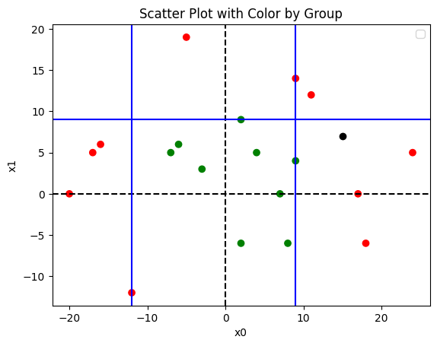
yes
no
x0=15, x1=7
yes
no
yes
no

Slide 64
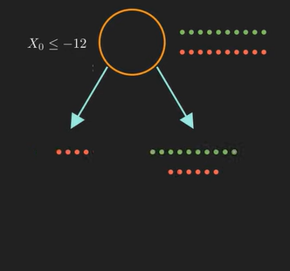
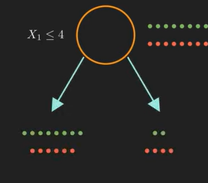
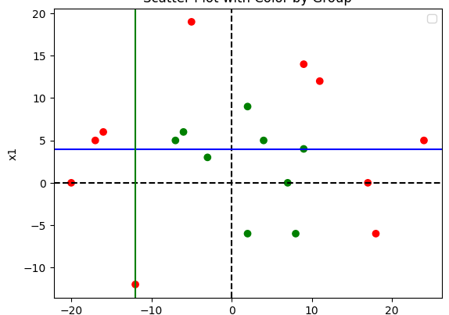
The model will choose the split which maximize information gain
Information gain calculates the reduction in entropy from transforming a dataset in some way.
Entropy, in the context of information theory and machine learning, is a measure of uncertainty or randomness in a system.

Slide 65
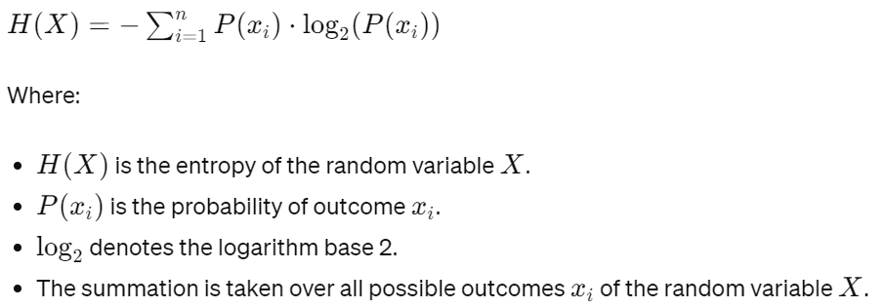
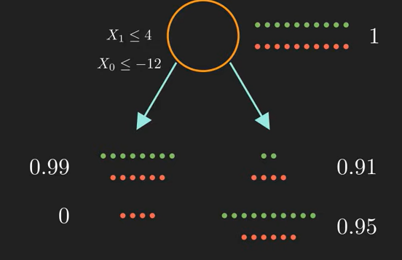
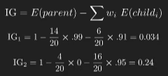
Entropy
https://planetcalc.com/2476/
Information gain

Slide 66
yes
no
yes
no
yes
no

Slide 67
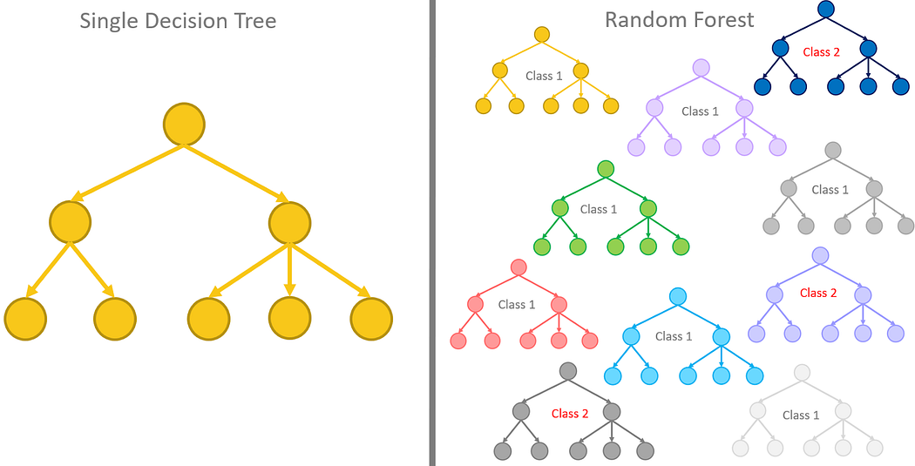
Random Forest

Slide 68
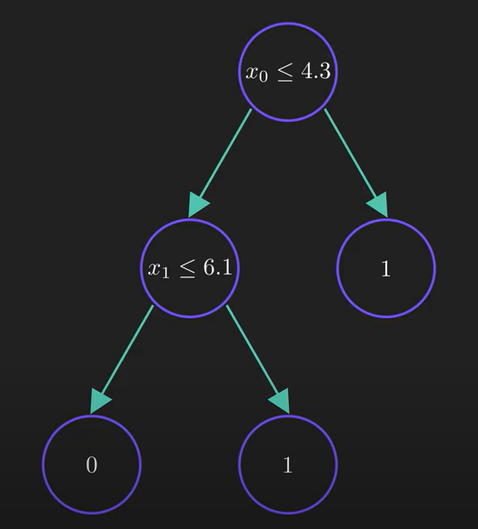
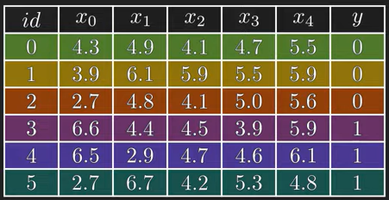
Why we need random forest?
yes
no
0,0,0,1
1,1
yes
no
0,0,0
1

Slide 69
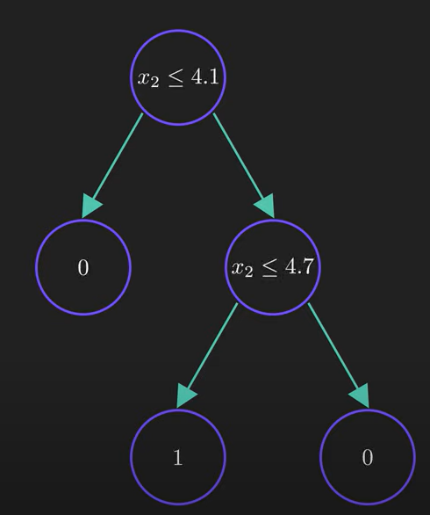
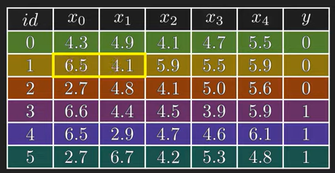
Small changes in dataset result in completely different decision tree

Slide 70
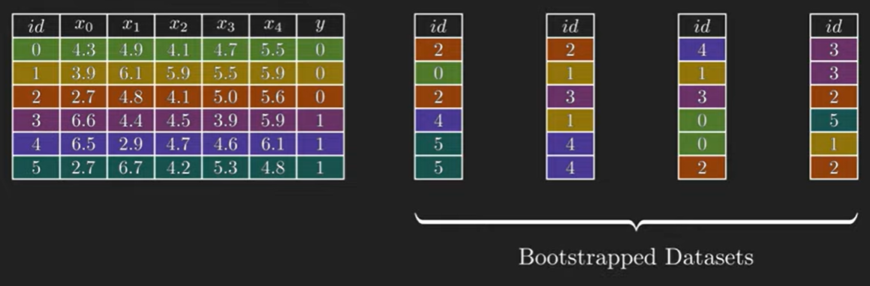
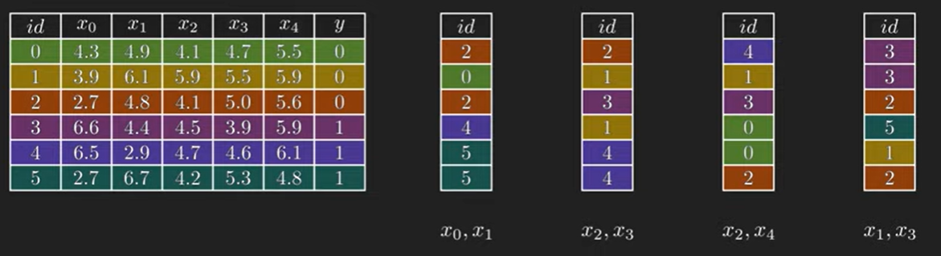
How random forest is build.
Random sampling with replacement
For simplicity, we build 4
Random feature selection

Slide 71


Slide 72

1
0
1
1

Slide 73
Gradient Boosting Tree
Sequential Learning: Gradient boosting is a type of ensemble learning where trees are built sequentially. Each tree corrects errors made by the previous ones, gradually improving the model's predictive accuracy.
Gradient Descent: It uses gradient descent optimization to minimize a loss function (like mean squared error for regression or log loss for classification). The next tree in the sequence focuses on reducing the residual errors left by the previous trees.
Weak Learners: Like random forests, gradient boosting uses decision trees as its base learners. However, unlike random forests that build trees independently, gradient boosting builds trees one after the other, with each new tree learning from the mistakes of the previous ones.
Boosting: The term "boosting" refers to the boosting process of combining multiple weak learners (simple models that perform slightly better than random guessing) into a strong learner that makes accurate predictions.
Weighted Errors: In each iteration, gradient boosting assigns higher weights to the data points that were previously misclassified or had larger errors. This focus on difficult-to-predict instances helps improve overall model performance.
Tree Depth: Gradient boosting typically uses shallow trees (with few levels or nodes) as weak learners. These shallow trees are simpler and faster to train, reducing the risk of overfitting.
Ensemble Prediction: The final prediction of a gradient boosting model is made by combining the predictions of all trees in the ensemble, often using weighted averaging or summing.

Slide 74
Gradient Boosting Tree
Sequential Learning: Builds trees sequentially to correct errors and improve predictive accuracy.
Gradient Descent: Minimizes a loss function using gradient descent to reduce residual errors.
Weak Learners: Uses decision trees as base learners, learning from previous mistakes.
Boosting: Combines weak learners into a strong learner for accurate predictions.
Weighted Errors: Assigns higher weights to misclassified data for improved performance.
Tree Depth: Uses shallow trees to prevent overfitting and speed up training.
Ensemble Prediction: Final prediction combines all tree predictions for accuracy.

Slide 75
XGBoost
Extreme Boosting: XGBoost is like a turbocharged version of gradient boosting. It's designed to be extremely efficient and effective in building predictive models.
Regularization: It incorporates regularization techniques to prevent overfitting, which is when a model learns too much from the training data and performs poorly on new data. This helps XGBoost produce more generalized models.
Tree Pruning: XGBoost uses a process called tree pruning, where it removes splits that don't provide significant improvement in predictive performance. This leads to simpler and more interpretable trees.
Parallel Processing: XGBoost can leverage parallel processing and distributed computing, making it faster and scalable to large datasets compared to traditional gradient boosting implementations.
Handling Missing Values: It has built-in capabilities to handle missing values in the data, reducing the need for preprocessing steps.
Customizable Objective Functions: XGBoost allows you to define and optimize custom objective functions, giving you flexibility to address specific problem requirements.
Feature Importance: It provides insights into feature importance, helping you understand which features have the most impact on the model's predictions.

Slide 76
XGBoost
Extreme Boosting: XGBoost is highly efficient and effective in building predictive models.
Regularization: Prevents overfitting and produces more generalized models.
Tree Pruning: Removes unnecessary splits for simpler and interpretable trees.
Parallel Processing: Faster and scalable to large datasets with parallel processing.
Handling Missing Values: Built-in capabilities to handle missing data, reducing preprocessing.
Customizable Objectives: Allows defining custom objective functions for specific requirements.
Feature Importance: Provides insights into important features impacting predictions.

Slide 77
LightGBM
Lightweight and Fast: LightGBM is designed to be highly efficient and faster than other gradient boosting implementations. It's optimized for large datasets and high-dimensional feature spaces.
Gradient Boosting: Like XGBoost, LightGBM is based on the gradient boosting framework. It builds trees sequentially, with each tree learning from the errors of the previous ones.
Leaf-Wise Growth: LightGBM uses a leaf-wise growth strategy for building trees. Instead of growing trees level by level (depth-wise), it grows trees leaf by leaf, choosing the leaf with the maximum reduction in loss during each split. This strategy can lead to deeper and more complex trees, capturing intricate patterns in the data.
Gradient-Based Learning: It uses gradient-based learning to optimize the split decisions during tree construction. This approach focuses on minimizing the loss function directly, leading to faster convergence and improved accuracy.
Categorical Feature Support: LightGBM provides native support for handling categorical features without the need for one-hot encoding, which can save memory and improve training speed.
Histogram-Based Optimization: LightGBM uses histogram-based algorithms to efficiently find the best split points during tree construction. This reduces the computational cost compared to exact algorithms, especially for large datasets.
Parallel Training: Similar to XGBoost, LightGBM supports parallel training, taking advantage of multiple cores or distributed computing environments to speed up model training.

Slide 78
LightGBM
Efficient & Fast: LightGBM is optimized for large datasets and high-dimensional features, offering speed and efficiency.
Gradient Boosting: Builds trees sequentially, learning from previous errors like XGBoost.
Leaf-Wise Growth: Grows trees leaf by leaf, capturing complex patterns efficiently.
Gradient-Based Learning: Optimizes split decisions directly for faster convergence and accuracy.
Categorical Feature Support: Handles categorical features without one-hot encoding, saving memory and improving speed.
Histogram-Based Optimization: Efficiently finds best split points, reducing computational cost, especially for large datasets.
Parallel Training: Supports parallel training for faster model training using multiple cores or distributed computing.

Slide 79
Data Preparation
Data Splitting (Train/Test)
Model Training
Model Evaluation
Data | Feature1 | Feature2 | Feature3 | Label | Prediction
Data1 | 23 | 3 | Cold | Cold
Data2 | 12 | 51 | Cold | Hot
Data3 | 1 | 12 | Hot | Hot
… | … | … | … | … | …
DataN | 15 | 65 | Hot | Cold | Cold
30%
Testing

Slide 80

ML Model – Evaluation Metrics

Slide 81


